Slide 1


Saxo Service Blueprint: Present and Future
Jinhong Brejnholt & Jimmi Hested
Enterprise Foundation

Slide 2

Agenda
1. Background
2. Design
3. Collaboration
4. Q&A

Slide 3


What doesn’t work
Production Environment

Slide 4
What doesn’t work
Production Environment

Slide 5

What doesn’t work
Complex and Inconsistent Process
Drift-Prone
Manual and Slow
Poor feedback
Difficult Disaster Recovery

Slide 6
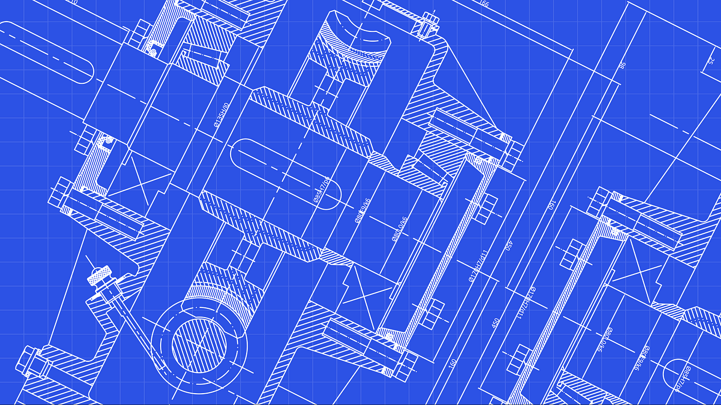

Saxo Service Blueprint
Notes:
Iac -> GitOps

Slide 7




Saxo Service Blueprint
Service

Slide 8
What doesn’t work
Complex and Inconsistent Process
Drift-Prone
Manual and Slow
Poor feedback
Difficult Disaster Recovery

Slide 9
What doesn’t work
Complex and Inconsistent Process
Drift-Prone
Manual and Slow
Poor feedback
Difficult Disaster Recovery

Slide 10
What doesn’t work
Simple and Consistent Target – Git
Drift-Prone
Manual and Slow
Poor feedback
Difficult Disaster Recovery

Slide 11
What doesn’t work
Simple and Consistent Target – Git
Constant Reconcile
Manual and Slow
Poor feedback
Difficult Disaster Recovery

Slide 12
What doesn’t work
Simple and Consistent Target – Git
Constant Reconcile
Automatic and Fast
Poor feedback
Difficult Disaster Recovery

Slide 13
What doesn’t work
Simple and Consistent Target – Git
Constant Reconcile
Automatic and Fast
Status visible at DevReach and Kubernetes
Difficult Disaster Recovery

Slide 14
What doesn’t work
Simple and Consistent Target – Git
Constant Reconcile
Automatic and Fast
Status visible at DevReach and Kubernetes
Built-in Disaster Recovery

Slide 15

What works ☺
Simple and Consistent Target – Git
Constant Reconcile
Automatic and Fast
Status visible at DevReach and Kubernetes
Built-in Disaster Recovery

Slide 16
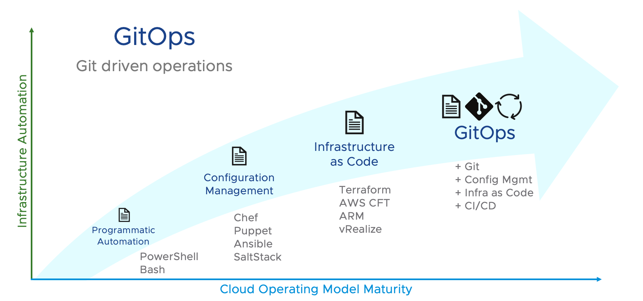

Slide 17
The Journey
Kubernetes Cluster
Blueprint
Crossplane
CCoE
CPE
EFE

Slide 18


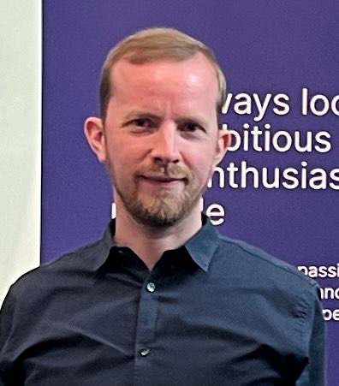


Enterprise Foundation Engineering
Oskar Kristiansen
Software Engineer
Travelling, boxing, cooking
Kristian Jensen
Senior Software Engineer
Fishing, nature, family
Jimmi Hested
Head of EFE
Football, family, technology
Ankur Singh
Senior Software Engineer
Cycling, travelling, driving
Jinhong Brejnholt
Product Owner
Cycling, table tennis, travelling

Slide 19
Plan
/
Azure Identity Role Assignment
Azure Managed Identity Provision
Azure SQL Access Provision
Kafka Topic Access Provision
Kubernetes Namespace Provision
Window Service AD Group Provision
VM Provision
Firewall Rule Updating
…
TLS Certificate Generation & Renewal

Slide 20
Status
Azure Identity Role Assignment
Azure Managed Identity Provision
Azure SQL Access Provision
Kafka Topic Access Provision
Kubernetes Namespace Provision
Window Service AD Group Provision
DNS
Kibana Namespace Provision
…
TLS Certificate Generation & Renewal

Slide 21
Saxo Service Blueprint
Service

Slide 22
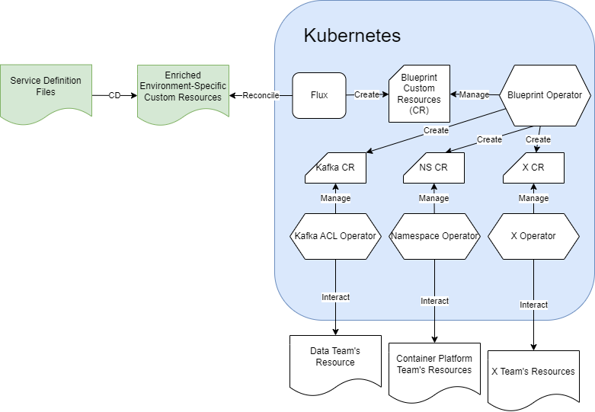
Saxo Blueprint Operators
Service

Slide 23
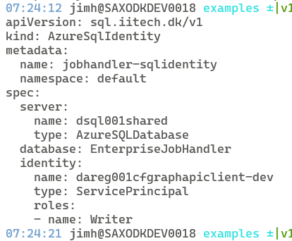
Kubernetes Custom Resource
Notes:
Kubernetes has an ace up its sleeve that makes it even more useful, powerful, and flexible. That ace is called an Operator. Operators exist because Kubernetes was designed from the beginning for automation, which is built directly into the very heart of the software. In fact, Kubernetes allows users to automate the deployment and execution of workloads, and also the way that Kubernetes does these things.
This is why Operators are so powerful: they enable complex clusters and systems to operate automatically based on a set of patterns and principles. In short, Operators are patterns that extend the behavior of the cluster without changing the Kubernetes code. Its APIs act as custom resource controllers.
To understand the purpose of an Operator, we must first understand what it is. Then, we can understand how Kubernetes works and why Operators are so useful.

Slide 24
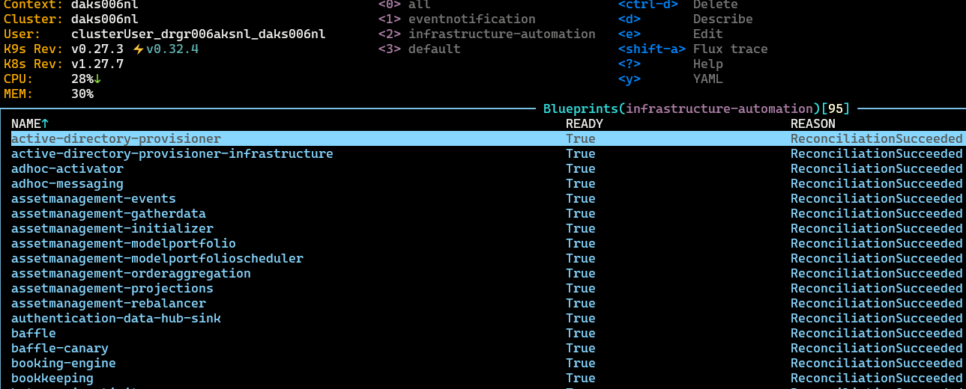
Blueprint view
Kubernetes Custom Resource

Slide 25
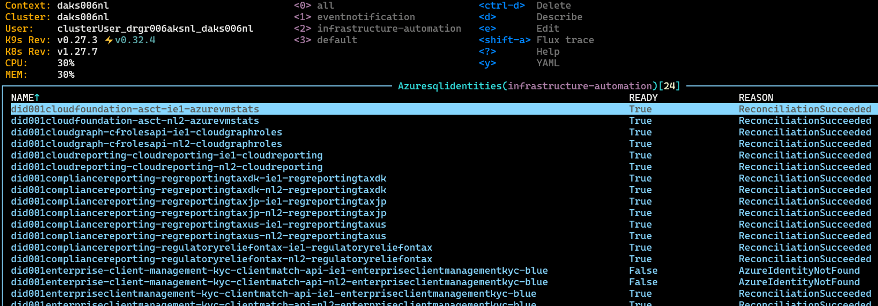
Database Roles View
Kubernetes Custom Resource

Slide 26
Organizational Structure
EFE
Data
App…
Container Platform Engineering
CCoE
Server Service

Slide 27
Organizational Structure
App…
EFE
Container Platform Engineering
CCoE
Server Service
Data

Slide 28
Organizational Structure
EFE
EFE
EFE
EFE
Data
App…
EFE
Container Platform Engineering
EFE
CCoE
Server Service
EFE
EFE

Slide 29

Collaboration

Slide 30

Collaboration

Slide 31



Next

Slide 32

Q & A

